Slide 1







Neurobots Hackathon: Team Agentic_AI
ISIP — Industrial Safety Intelligence Platform
Team Members
Project Overview
Team Name
Joyal
Axon
Vision Pipeline
Domain
Anandhu
Edge AI for Industrial Safety & Autonomous Hazard Detection
Orchestrator
Platform
Giri
ISIP — Industrial Safety Intelligence Platform
Telemetry
Boss
Control Plane
Adithyan
Dashboard

Slide 2
Problem Statement
Why industrial safety AI is urgently needed
45%
5000ms+
$2.3B
Incidents Missed
Cloud Latency
Market Size
CCTV operators miss nearly half of safety incidents due to fatigue monitoring 8–16 feeds over 8+ hour shifts
Cloud-based safety systems add 500ms–2s latency — far exceeding the ISO 13849-1 requirement of <1s response
Industrial safety market addressable by edge-first AI, particularly for offline, rural, and bandwidth-constrained facilities
The Consequence of One Missed Incident
Target Users & Context
A single undetected safety event can result in equipment failure, toxic chemical exposure, or fatal injury. Human operators are physiologically incapable of sustained multi-feed vigilance — the system, not the operator, must close the gap.
Mining, oil & gas, manufacturing, construction — safety-critical environments with zero tolerance for missed alerts
Rural and off-grid facilities with limited or zero cloud connectivity
Edge-first is the only viable architecture for offline industrial deployments

Slide 3


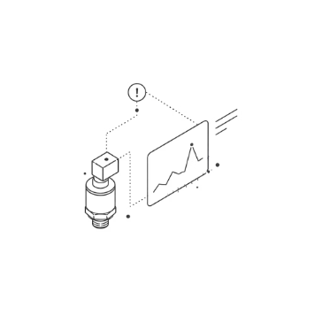
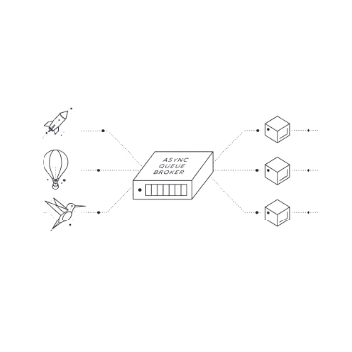
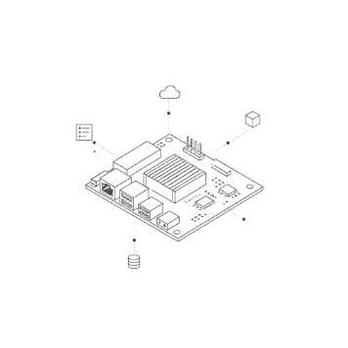

Proposed Solution: Edge-First Safety AI
Core Innovation: Sub-20ms autonomous safety loop — detection → decision → E-Stop relay — entirely on-device with zero network dependency.
YOLOv8 Vision
IIoT Telemetry
Async Event Broker
Hardware Agnostic
Real-time PPE compliance, geofencing, and hazard detection. Helmet, vest, person, and machine classes — live bounding box overlays with confidence scores.
Temperature, vibration, and gas anomaly detection via Z-score + EMA. Arrhenius-based Remaining Useful Life (RUL) prediction for predictive maintenance.
Priority-aware pub/sub architecture ensures safety events are never blocked by slow dashboards or heavy analytics workloads.
Runs on Jetson Orin Nano ($249), Raspberry Pi 5 + Hailo-8 ($200), or Intel NUC. No vendor lock-in, no cloud subscription required.
Only edge-first solution meeting ISO 13849-1 PLd/PLe safety integrity levels while operating fully offline in bandwidth-constrained facilities.

Slide 4
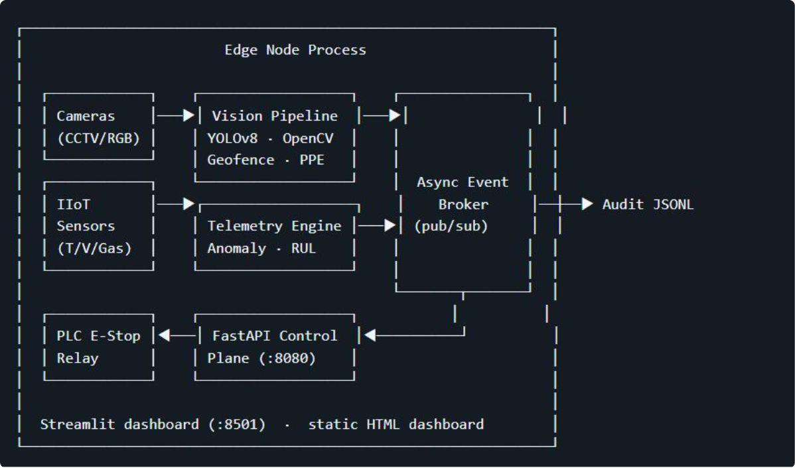
Technical Architecture
Three-layer pipeline with async orchestration and safety-critical output
The system processes two parallel data streams — video and sensor telemetry — through a central async event broker that prioritizes safety-critical events, ensuring the E-Stop relay trip path is never blocked by lower-priority output tasks.
AI Models
REST API Endpoints
YOLOv8n
Method
Endpoint
Description
Object detection — Helmet, Vest, Person, Machine classes. Real-time inference at 30 FPS (Jetson) / 15–20 FPS (Pi).
GET
/health
Node status snapshot
GET
/metrics
Latency, FPS, alerts, E-Stop state
Z-score + EMA
GET
/events
Recent broker events
Anomaly detection on streaming telemetry — catches thermal drift, vibration spikes, and gas concentration anomalies.
GET
/audit
JSONL audit ledger rows
POST
/trigger-estop
Trip PLC relay (mode=HARD)
Arrhenius RUL
Technology Stack
Thermal degradation curve used to predict Remaining Useful Life of industrial equipment before failure occurs.
Python 3.11
FastAPI
Streamlit
YOLOv8
OpenCV
Pydantic
Uvicorn

Slide 5


Current Progress: Proof of Work
Working prototype with full-stack implementation — ready for live demonstration
📁 GitHub Repository
🖥️ Working Prototype Hardware
Full source code with modular architecture under src/isip/:
Jetson Orin Nano
Raspberry Pi 5 + Hailo-8
vision/
iiot/
30 FPS YOLOv8 real-time inference · $249 edge node
15–20 FPS inference · $200 entry-level deployment
events/
api/
🎥 Project Demo Video
Live demonstration covering: YOLOv8 inference on live feed, geofence breach detection, telemetry anomaly detection, and E-Stop relay trip. Duration: 2–3 minutes.
control/
dashboard/
Also includes tests/, config/, and scripts/ directories. Full unit test coverage and CI configuration.
Demo video link embedded — showcases full end-to-end autonomous safety loop in action.
📊 Streamlit Dashboard
⚡ FastAPI OpenAPI Docs
🤖 AI Models & Dataset
Live video overlay with bounding boxes · Telemetry charts (temperature, vibration, gas) · RUL gauge · E-Stop control buttons. Also includes a static HTML terminal-style dashboard for air-gapped facilities with no browser dependencies.
Interactive Swagger UI at /docs with all 5 endpoints documented — including request/response schemas for /trigger-estop. Health, metrics, events, and audit endpoints fully tested.
YOLOv8n deployed and validated on synthetic sensor data
Z-score + EMA validated on synthetic telemetry streams
Dataset: synthetic camera feed + emulated IIoT sensors (temperature, vibration, gas)

Slide 6


Live Demo: What Works Now
Vision Pipeline Feature Map
Telemetry Engine Flowchart
Input Frame
Sensor Input
YOLOv8n Inference
Anomaly Detection
Class Detection
RUL Estimation
Geofencing & Overlay
Severity → Broker
YOLOv8 detects: Helmet, Vest, Person, Machine
Point-in-polygon geofencing via cv2.pointPolygonTest
Real-time bounding box overlay with confidence scores
Z-score + EMA catch thermal drift and vibration spikes
Arrhenius-based RUL predicts equipment failure before it occurs
Severity classes: INFO / WARNING / CRITICAL
Safety Loop Performance
<200ms
70 FPS
100%
Full Safety Loop
Vision Inference
Offline Operation
Geofence breach → event broker → E-Stop relay trip. Measured on Jetson Orin Nano.
Real-time YOLOv8n inference on Jetson Orin Nano with live bounding box overlays and zone violation highlighting.
Append-only JSONL audit trail ensures full compliance logging with zero cloud dependency. Air-gap ready.
Live demo shows: video feed with zone violations, telemetry charts with anomaly markers, RUL countdown gauge, and E-Stop interface — with latency metrics overlay (e.g., 18.4ms).

Slide 7




Challenges & Next Plan
Honest assessment of current blockers and the roadmap to production
Current Challenges
Remaining Work Before Final Round
Real-World PLC Integration
Phase 1 — Hardware Validation
Siemens S7 and Allen-Bradley CompactLogix are currently mocked via GPIO/Modbus-TCP abstraction layer. Production deployment requires vendor-specific OPC-UA drivers not yet implemented.
Validate sub-20ms latency on real Jetson/Pi hardware in a live industrial facility environment. In progress.
Phase 2 — PLC Integration
Thermal RUL Validation
Integrate with 1–2 industrial PLC systems, beginning with Siemens S7 pilot using full OPC-UA driver stack.
Arrhenius degradation model validated only in simulation. Production calibration requires real equipment degradation data from partner industrial facilities.
Phase 3 — Facility Pilot
Deploy at a partner facility (mining or manufacturing) with real sensor data to validate RUL model and end-to-end safety loop performance.
Hardware Cost Optimization
Hailo-8 supply chain constraints are a deployment risk. Evaluating alternative accelerators: Coral TPU and Qualcomm Snapdragon as contingency options.

Slide 8






Impact & Scalability
From hackathon prototype to $2.3B industrial safety market
30–40%
$2.3B
$200
Downtime Reduction
Market Opportunity
Entry Hardware Cost
Predictive RUL estimation reduces unplanned equipment downtime through early failure warnings.
Total addressable industrial safety market. Edge-first is the only solution for offline, bandwidth-constrained facilities.
Same software runs on a $200 Raspberry Pi (15–20 FPS) or a $10K Jetson cluster (100+ FPS). No vendor lock-in.
Who Benefits & How
Future Scope
Lives Saved
SaaS + Hardware Bundle
Autonomous detection prevents injuries and fatalities that fatigued human operators inevitably miss. Removes the human-vigilance bottleneck from safety-critical processes.
Commercialize as a managed hardware-software package for industrial safety teams
Compliance Certainty
ERP Integration
Append-only JSONL audit trail eliminates the "I didn't see it" defense in post-incident investigations. Full ISO 13849-1 PLd/PLe integrity level compliance.
Connect with SAP and Oracle for predictive maintenance workflows and automated work-order generation
Zero Cloud Cost
Expand Safety Domains
No cloud subscription, no bandwidth overage fees, no single point of failure. Works fully offline in remote mining, oil & gas, and off-grid manufacturing sites.
Fire detection, structural health monitoring, confined space entry tracking

